Slide 1
ECE 3561
Advanced Digital Design
Class 11: Counters 2 – Other Sequences Counter Design
Drew Phillips
Spring 2024

Slide 2
Counter Design Procedure Summary
Determine counting sequence.
Determine number (and type) of FFs.
Construct truth table with state and next state combinations.
Determine FF input excitations for each state to next state transition and add to truth table.
Determine FF input excitation equations using K-map.
Draw the counter circuit logic diagram using the FFs and the combinational logic from the excitation equations.

Slide 3
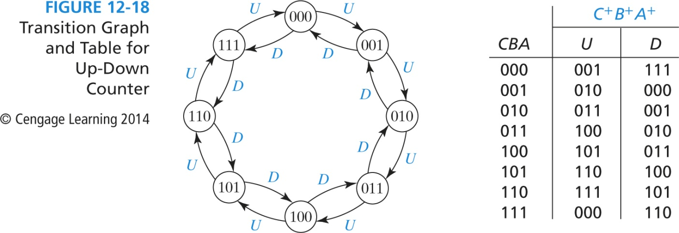

Ex 3: Up-Down Modulo-8 Counter
U: counting up
D: counting down
Observe when counting down:

Slide 4
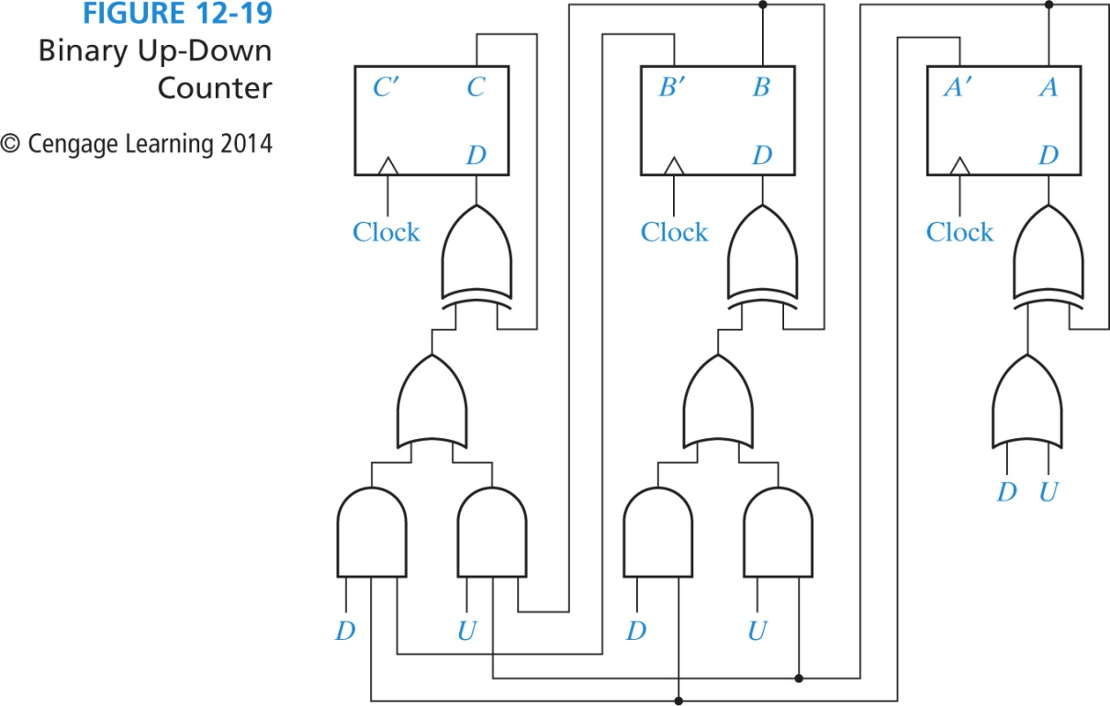

Ex 3: Up-Down Modulo-8 Counter
Note that now we only transition states when U or D is set.

Slide 5
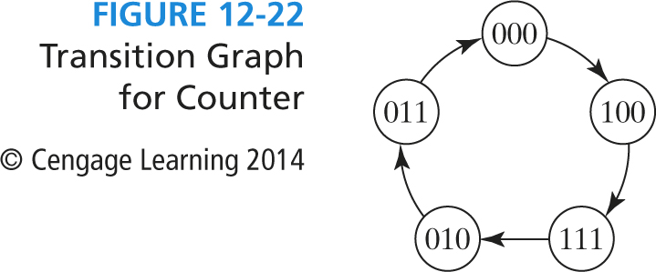
Ex 4: Other Sequence Counter
Count sequence:
  0 → 4 → 7 → 2 → 3 → 0 → …
Not used:
  1, 5, 6: these states don’t have next states (they are “don’t cares”)

Slide 6
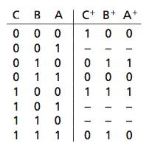
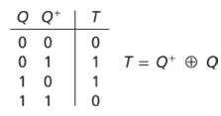
Ex 4: Other Sequence Counter

Slide 7
Ex 4: Other Sequence Counter

Slide 8
Ex 4: Other Sequence Counter

Slide 9
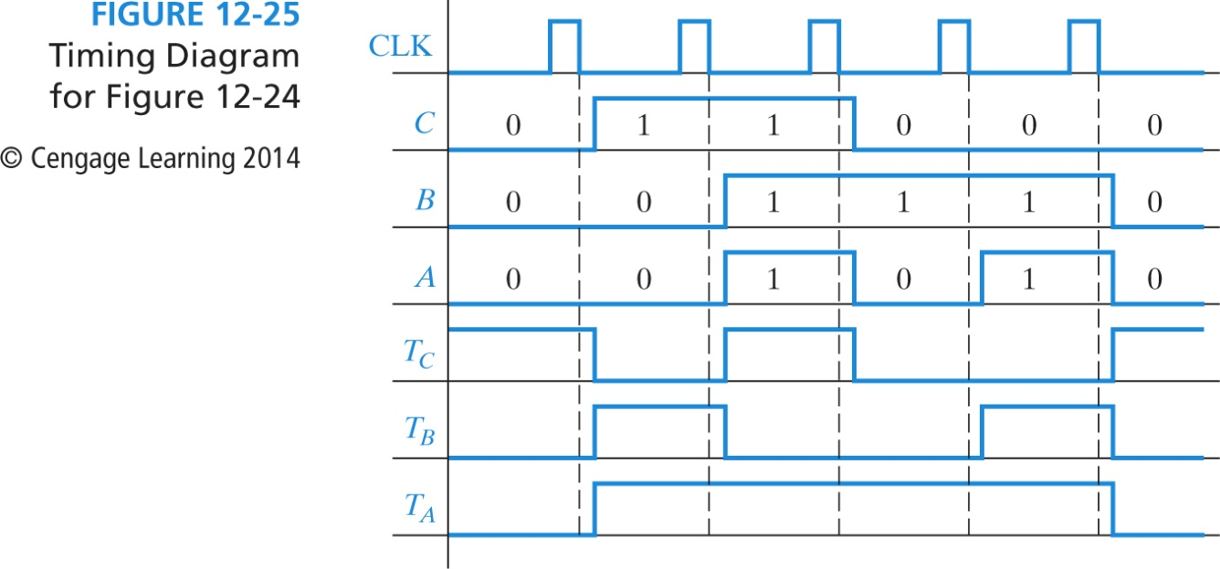
Ex 4: Other Sequence Counter
Could you design the counter if you were given only the timing diagram?
The complete timing diagram shows the counting sequence and the FF excitation signals.

Slide 10
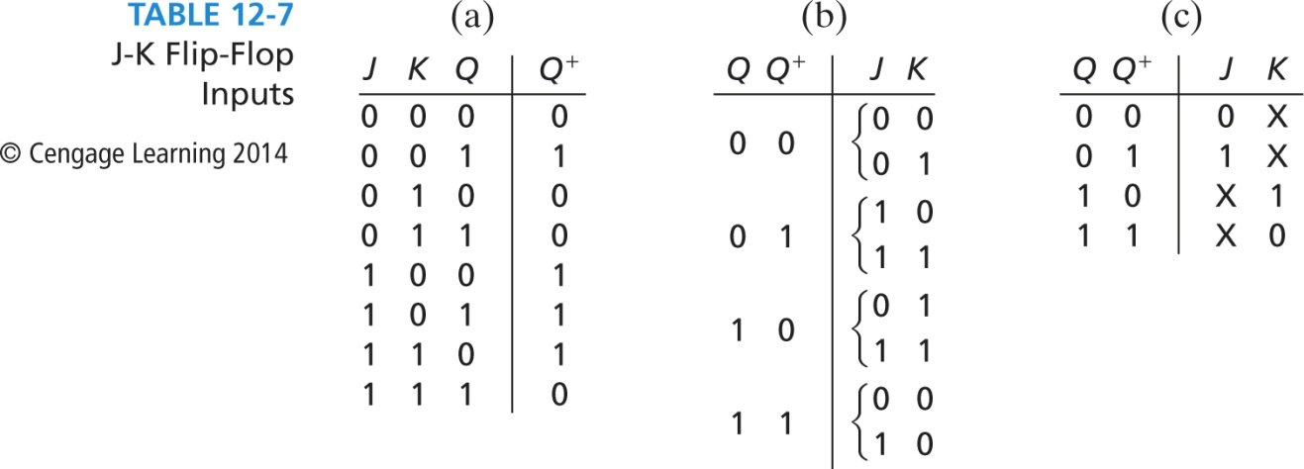
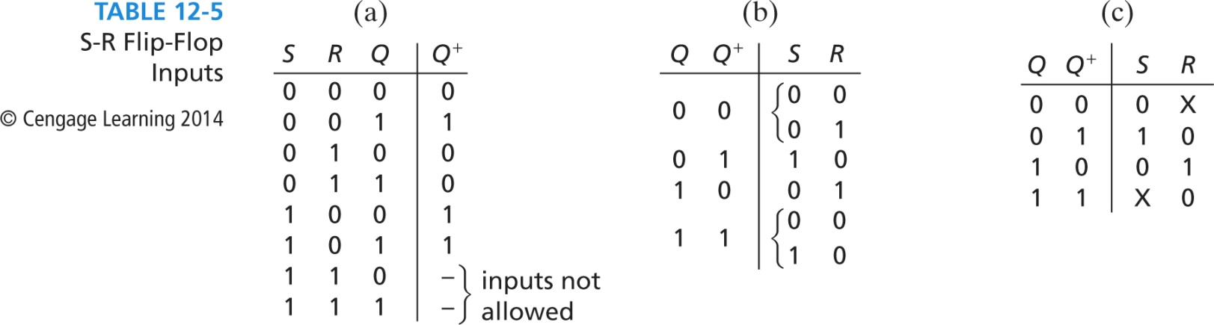
Counter Design with SR/JK FFs
Compare Excitation Signals

Slide 11
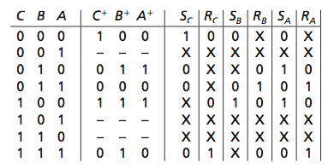
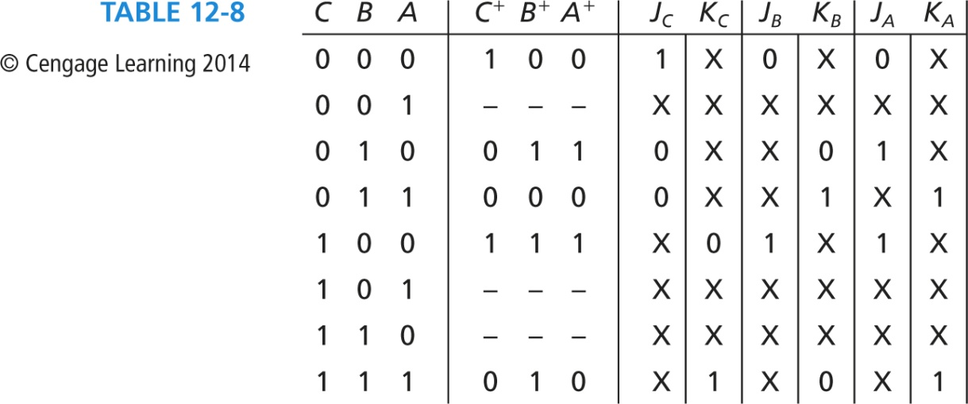
Ex 5/6: Redesign with SR/JK FFs
Counter sequence: 0 → 4 → 7 → 2 → 3 → 0 → …

Slide 12
Ex 5/6: Redesign with SR/JK FFs

Slide 13
Ex 5/6: Redesign with SR/JK FFs

Slide 14
Counter Design Procedure Summary
Determine counting sequence.
Determine number (and type) of FFs.
Construct truth table with state and next state combinations.
Determine FF input excitations for each state to next state transition and add to truth table.
Determine FF input excitation equations using K-map.
Draw the counter circuit logic diagram using the FFs and the combinational logic from the excitation equations.

